Slide 1
Feasibility of a servo motor or pendulum for testing the wave-powered desalination pump

Slide 2
Summary
Servo motor from Clearpath cannot handle the peak or rms torque needed with a realistic spool size
  Adding a speed reducer (torque increaser) gearbox from McMaster available models doesn’t affect this either
  Ivan found this servo would be the best option for easy usability and within our budget (~$1000), as the drive and control are incorpated into one unit within in the actuator
  The 1-phase 110VAC option and 3-phase 230V option have the same peak and rms torque, but the 230V allows for these torque at higher speeds (see torque-speed plots on next slide)
  This is the largest motor from them with incorporated drive and controller
Pendulum natural frequency is around 2 s, which is too short to allow for filling the accumulator or producing any water
  Feed pressure never gets high enough to produce permeate
  Also the pendulum mass required is unrealistic (Need something like 30-40 45 lb plates to allow for multiple periods)
  Could try without the accumulator, but this wouldn’t simulate our system, and also the hydraulic shocks could damage the RO membrane (which is why we have an accumulator)
Recommendation for testing: Apply through the TEAMER program (free testing if accepted) to test at the NREL 5 kW dynamometer
  We DON’T need 3-phase power in O’Brien as it would not help (unless we want to get a bigger actuator an invest more time and money into it)
  Could also look into using the hydraulic linear actuators the Civil department has, but this isn’t as easy as going to the NREL dyno
Also still need to design the salt water flow loop which allows for permeate and brine to incorporate back to “ocean” conditions
  Most likely this is just 3 tanks (1 for permeate, 1 for brine, 1 for combining the two back into feed)
  The tests could be run until the feedwater is out, then the brine and permeate would be combined and the salt allowed to fully dissolve before running the next batch of tests

Slide 3
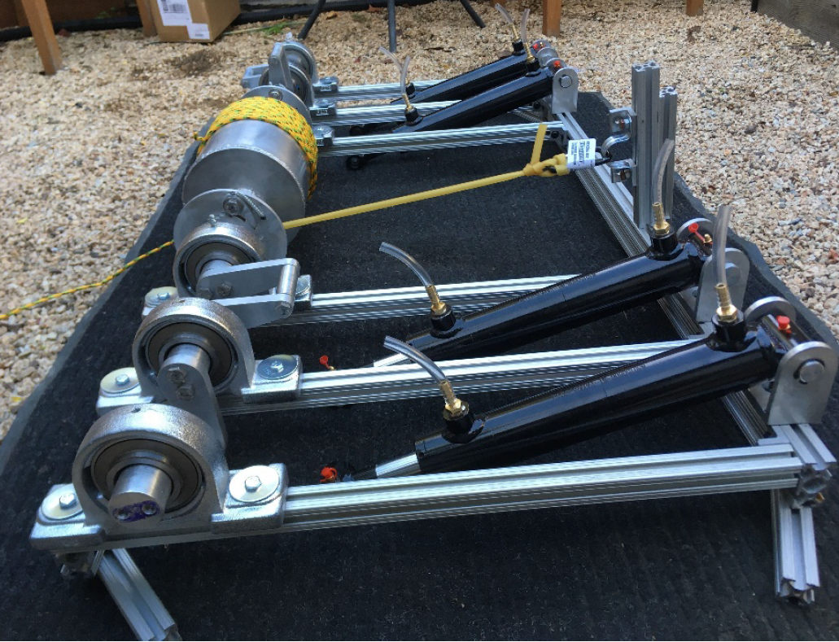
Reminder of what the actuator / pendulum is for
Develop a test stand and actuator to provide the variable speed, variable force, oscillating direction, low speed input for the rotary crankshaft pump
Fabricate and assemble high pressure rotary pump prototype
Force and Velocity from modeled sea states
Actuator
Spring and Mass system
Pendulum
Electric motor
Hydraulic motor
Hydraulic linear piston
Hand crank
Others?
Ivan previously investigated these different options in his Spring 2021 ME 180 report
High Pressure Rotary crankshaft pump prototype

Slide 4
Reminder of what the actuator / pendulum is for
Develop a test stand and actuator to provide the variable speed, variable force, oscillating direction, low speed input for the rotary crankshaft pump
Fabricate and assemble high pressure rotary pump prototype
Pendulum
Force and Velocity from modeled sea states
High Pressure Rotary crankshaft pump prototype

Slide 5
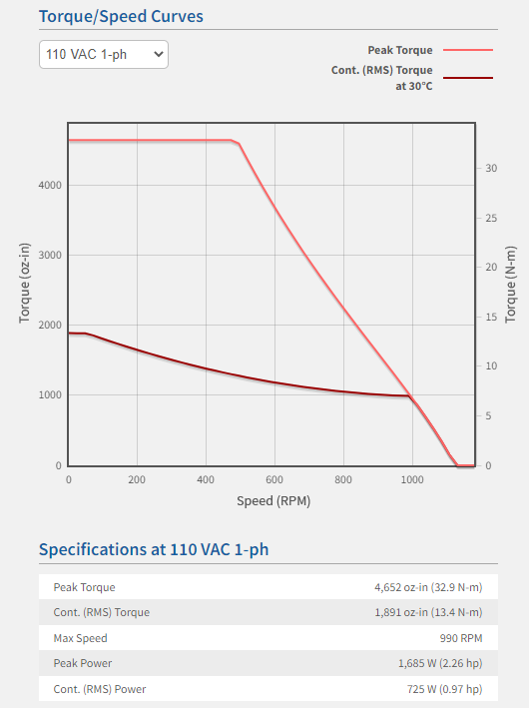
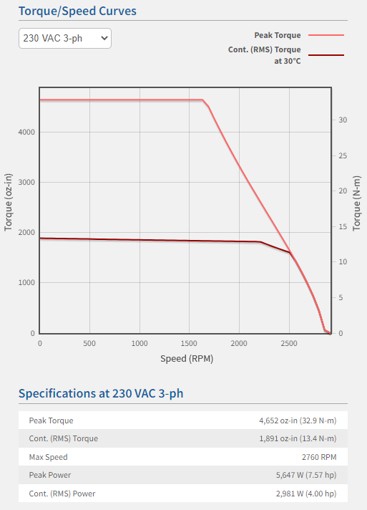
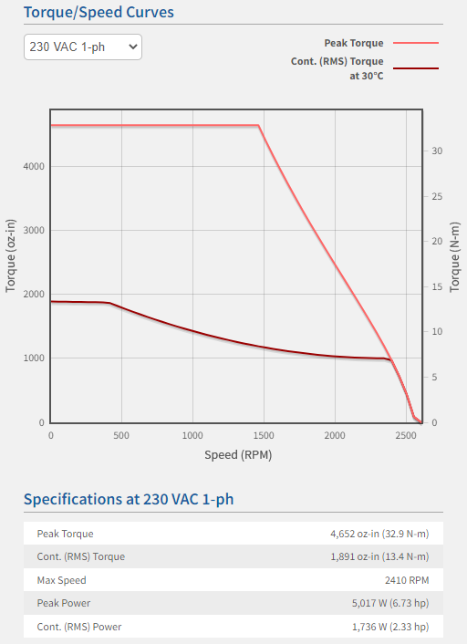
Rotary Actuator Specs
Difference between single phase 110 V and 3-phase 230 Vis the extension of peak and rms torques to higher speeds

Slide 6
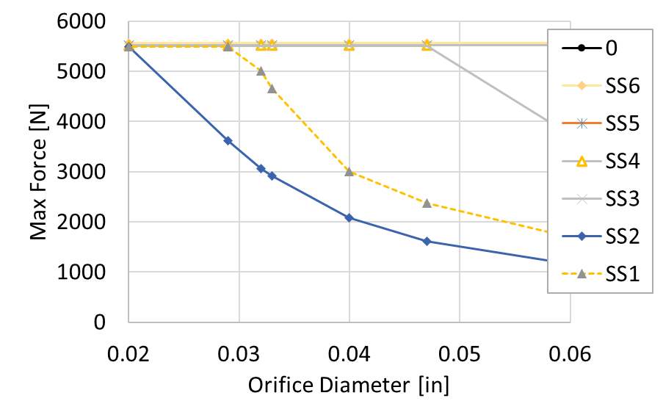
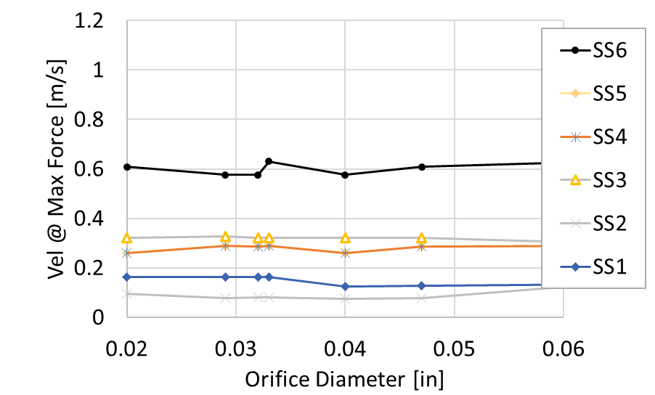
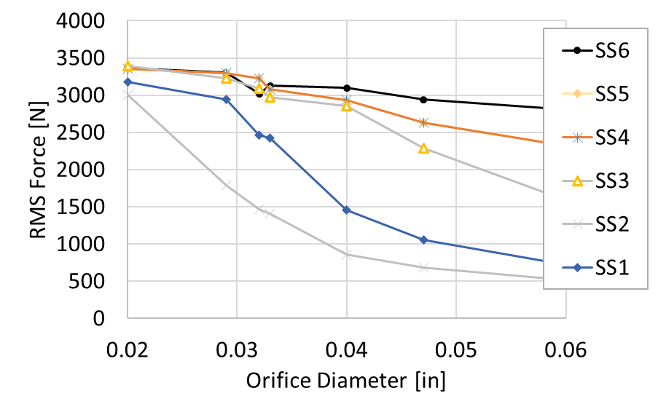
Expected linear forces and velocities from Simulink simulation
Design parameters selected:
  crank arms 0.05 m in length between drive shaft and pin
  Mooring drum 10” (0.254 m) in diameter
  Hydraulic cylinders bore 1.97” (0.05 m) – using two 180 deg offset on crankshaft
  Flow restrictor orifice diameters between 0.02” and 0.06” (in a 0.25” pipe or hose) – each is $10 on McMaster
  16.5 fl. oz accumulator
ClearPath Servo Motor capacity
  See the charts on previous slide ~$1000
SS1: T=6 s | A=0.25 m
SS2: T=10 s | A=0.25 m
SS3: T=6 s | A=0.5 m
SS4: T=7 s | A=0.75 m
SS5: T=7 s | A=1.0 m
SS6: T=7 s | A=1.5 m

Slide 7
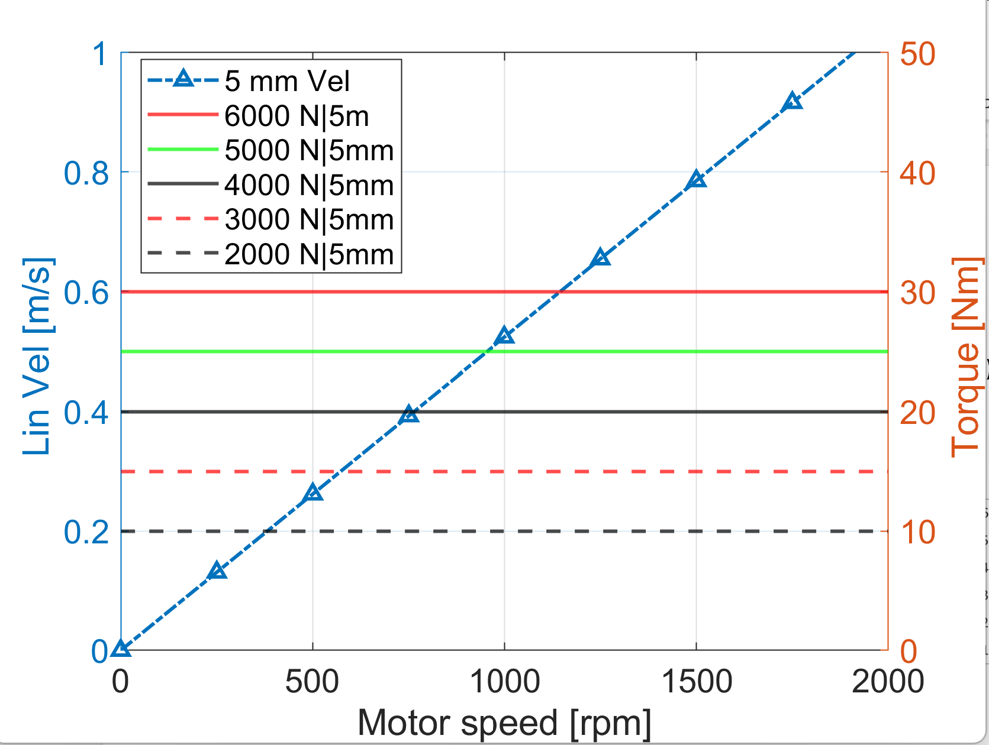
Need a 5mm radius spool on actuator for Safety Factor of 1…….
Design parameters selected:
  crank arms 0.05 m in length between drive shaft and pin
  Mooring drum 10” (0.254 m) in diameter
  Hydraulic cylinders bore 1.97” (0.05 m) – using two 180 deg offset on crankshaft
  Flow restrictor orifice diameters between 0.02” and 0.06” (in a 0.25” pipe or hose) – each is $10 on McMaster
  16.5 fl. oz accumulator
ClearPath Servo Motor capacity
  See the charts on previous slide ~$1000
With these expected forces (5500 N max | 3000 N RMS)
Actuator peak torque of 33 Nm | 13 Nm rms torque
**We need a ~5mm radius spool on actuator
SS1: T=6 s | A=0.25 m
SS2: T=10 s | A=0.25 m
SS3: T=6 s | A=0.5 m
SS4: T=7 s | A=0.75 m
SS5: T=7 s | A=1.0 m
SS6: T=7 s | A=1.5 m

Slide 8
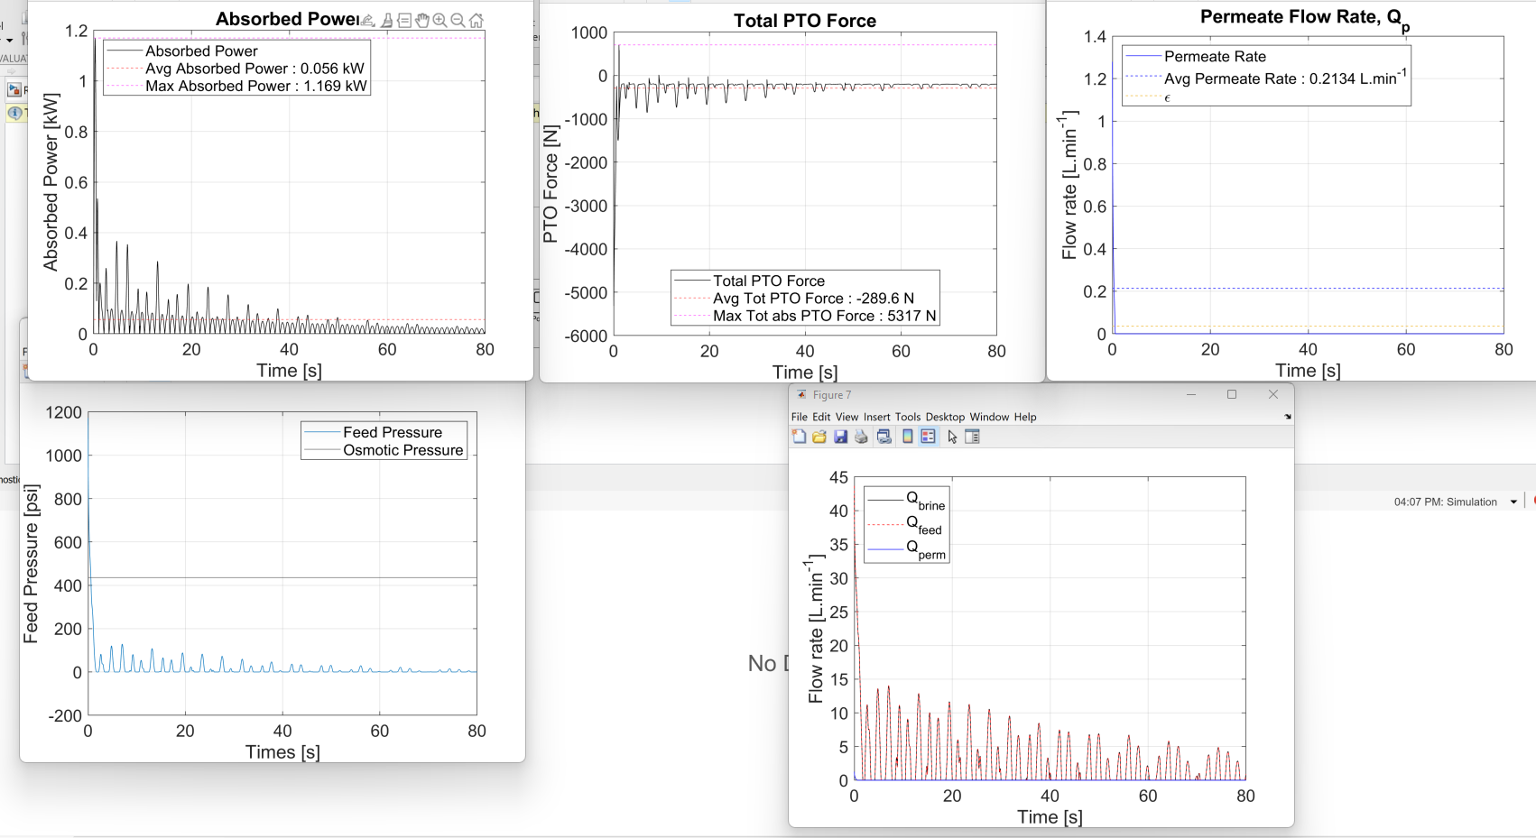
Pendulum
1 m long pendulum | 40 45 lb plates | 0.02” orifice diameter – Pressure never gets high enough

Slide 9
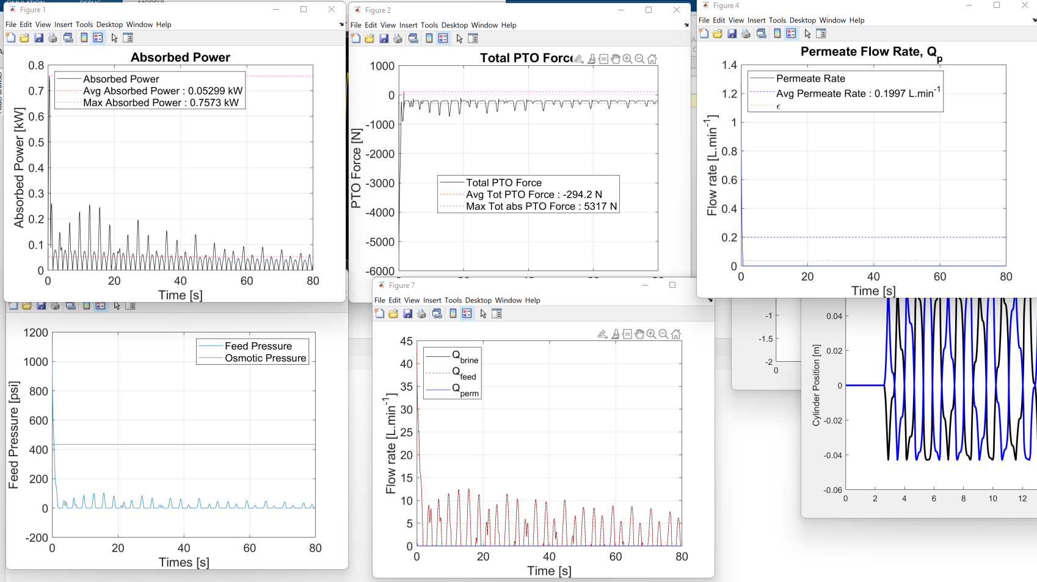
Pendulum
2 m long pendulum | 40 45 lb plates | 0.02” orifice diameter – Pressure never gets high enough

Slide 10
Crank arm dimensions for machining
D=25.8mm (1.015” for a 1” pin)
D=9 mm (clearance hole for an M8 bolt) – double check with KB what size clearance hole he is using
D=38.5mm (1.515”)
50 mm (1.515“)
19.24 mm (0.758“)
50 mm (1.969“)
88.5 mm (3.484”)

